Slide 1


Beyond the Disclosure Statement: Attributing Human-AI Contribution in Shared Work
AI + OER INSTITUTE 2026 · SATURDAY, AUGUST 8, 2026
Victoria Brame & Chris Macek · Co-Founders, Clear Box
IN CHAT:
Describe a piece of work you collaborated on or contributed to this week, with people or AI.
Beyond the Disclosure Statement: Attributing Human-AI Contribution in Shared Work © 2026 by Clear Box is licensed under CC BY 4.0

Slide 2
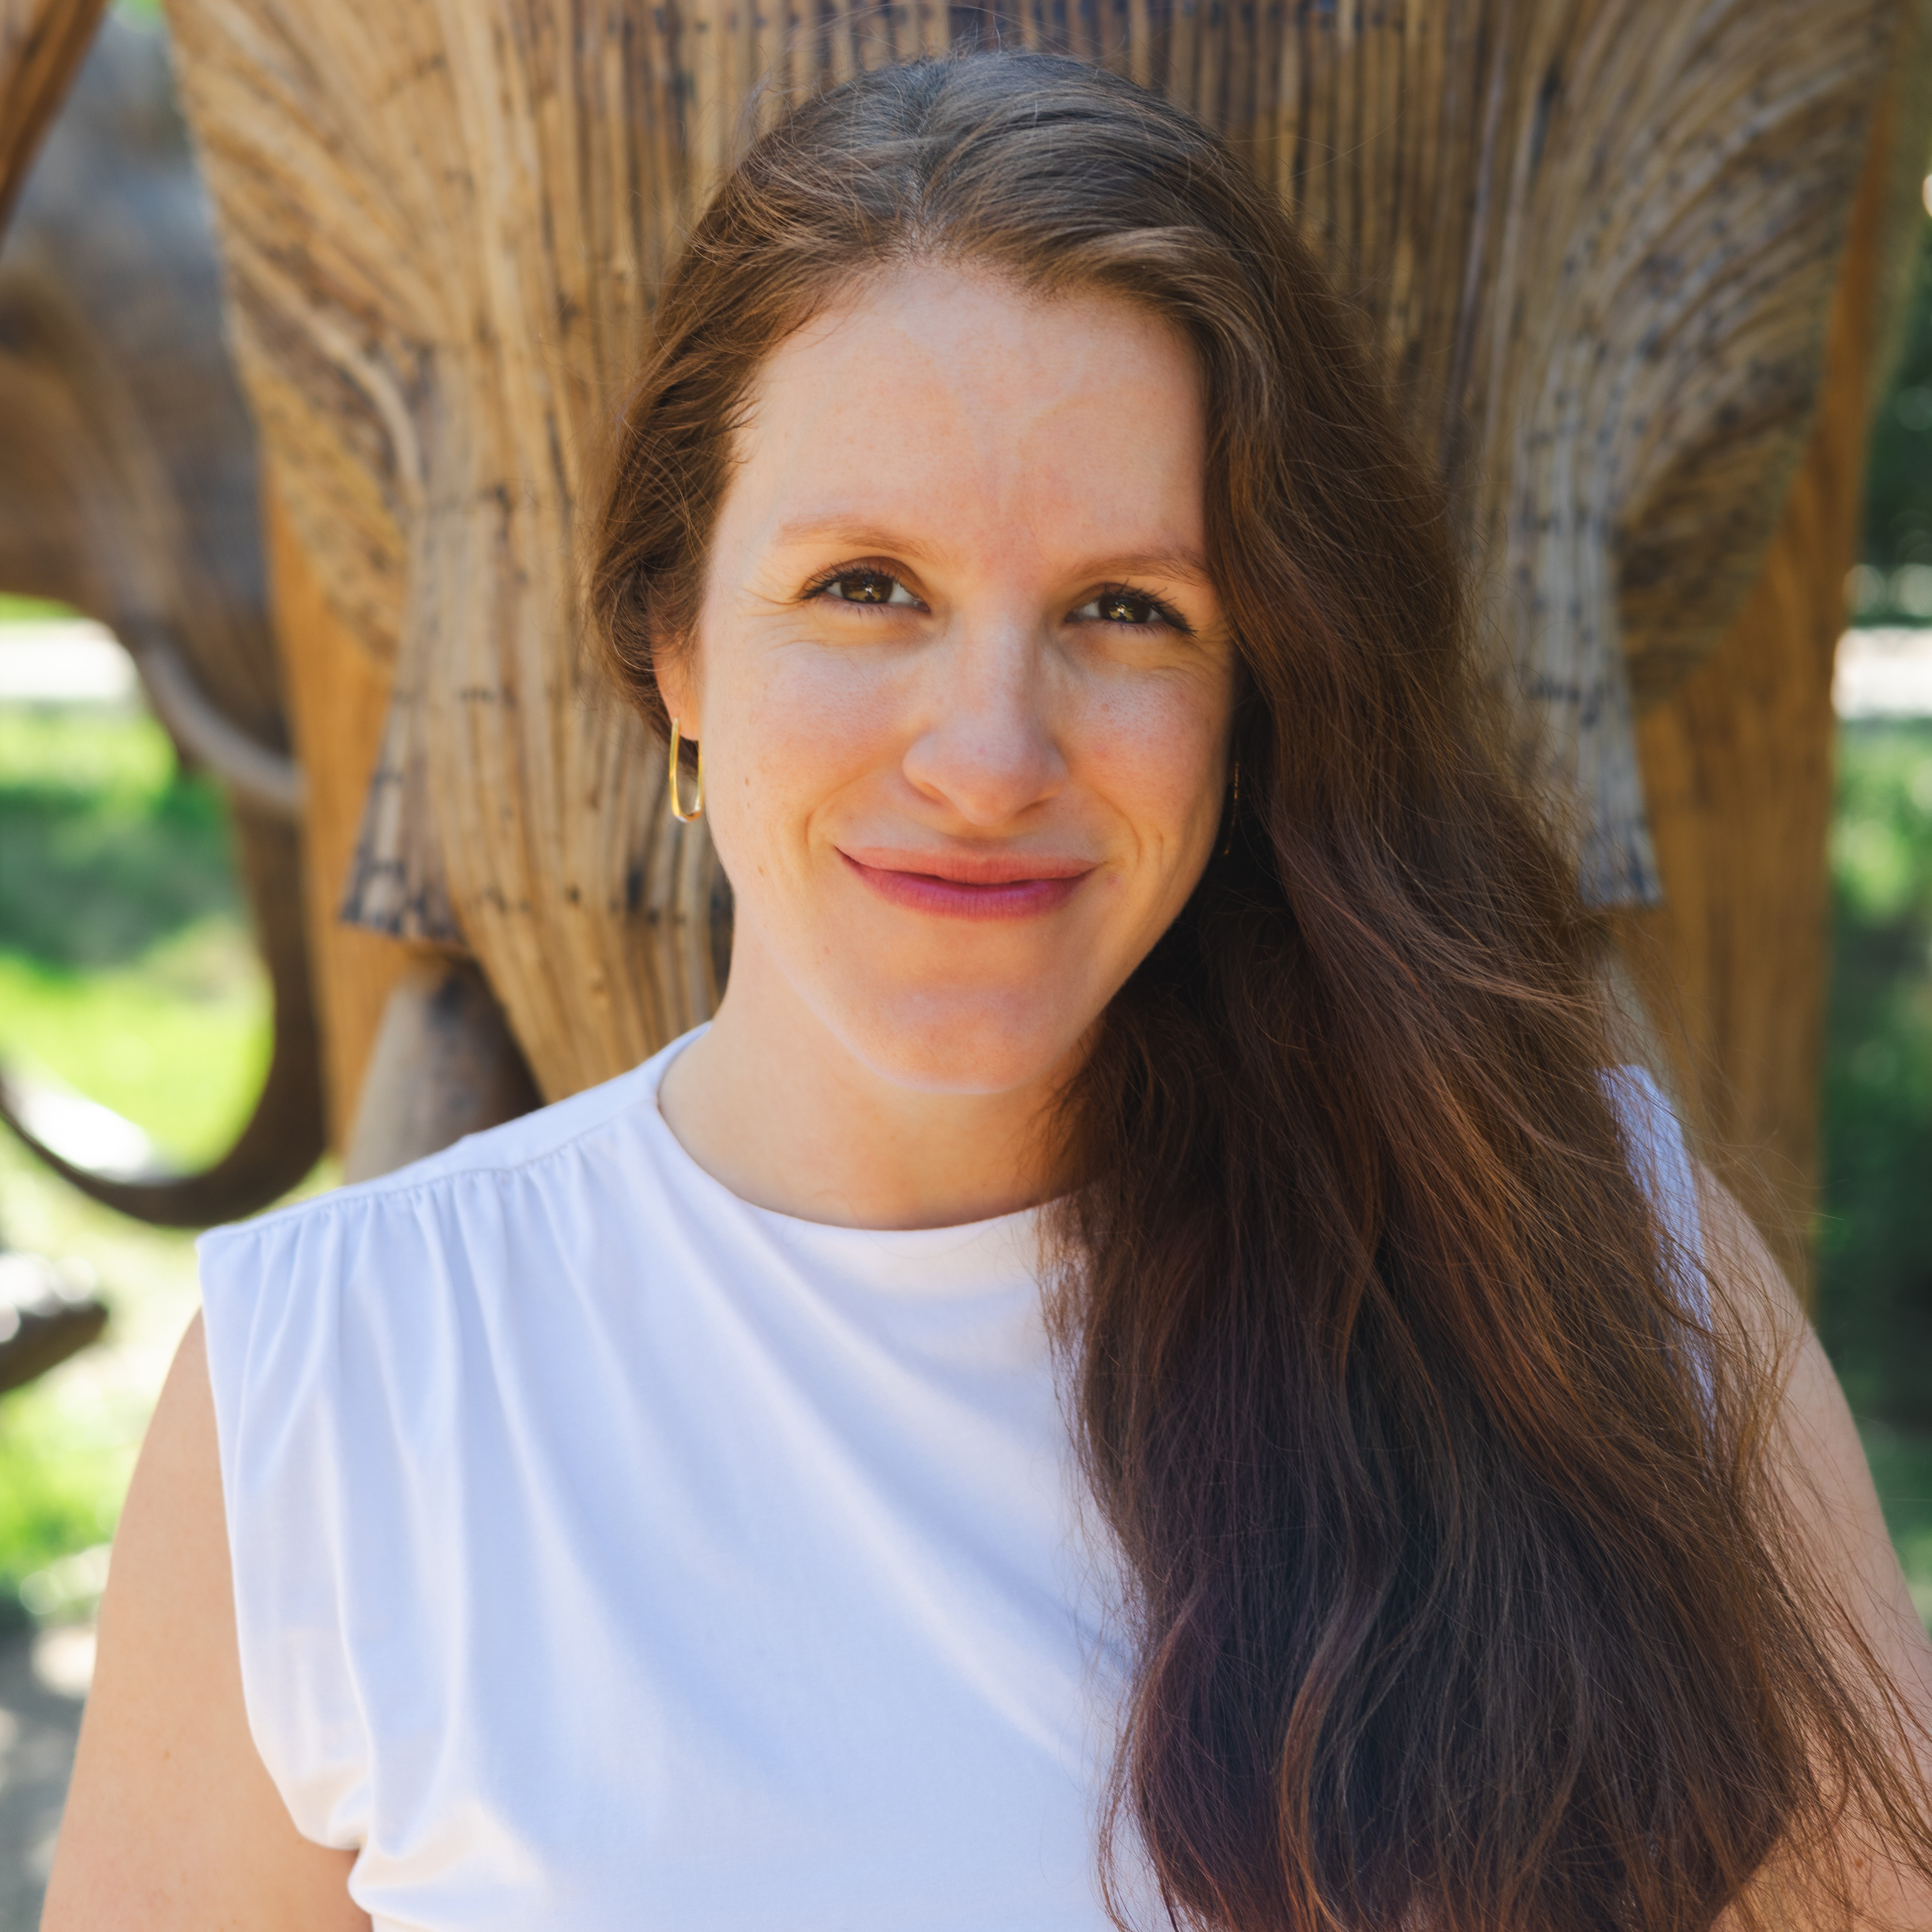
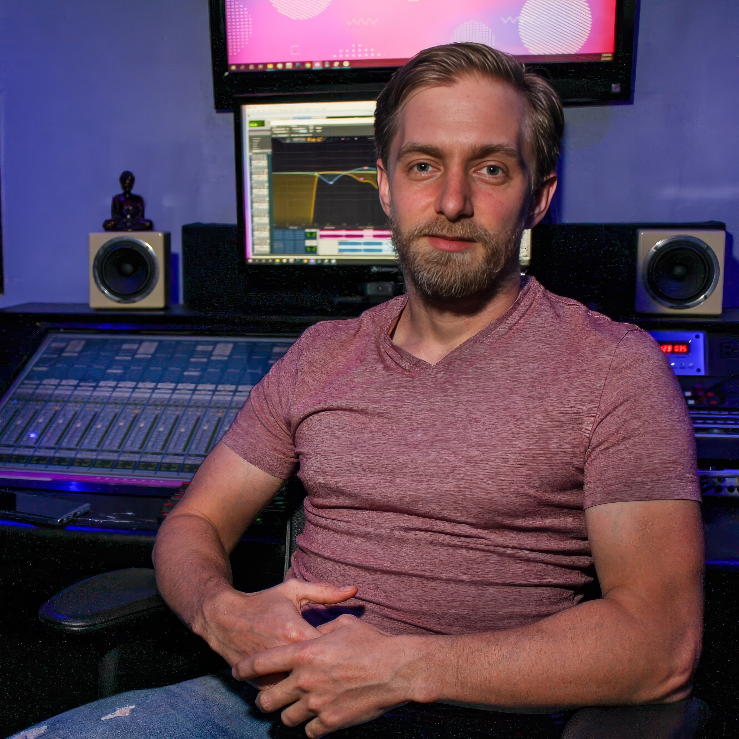

About Us
Victoria Brame
Chris Macek

Slide 3
Lessons Learned
1
Creatives will always find use of a new technology if it helps their craft.
2
Four layers of contribution are present in every creative, shareable work. Any field. Human or AI.
D
A
R
P
Devise
Author
Review
Prepare

Slide 4
DARP Basics
An attribution framework and taxonomy for the creative process of making and sharing work…
by anyone, in any field.
for human contributions, AI contributions, or both.
The Layers of Contribution
The Acts of Contribution
BROAD TO SPECIFIC
The Trade Words for Contribution
SCOPE WORDS
sole · lead · supporting · equal

Slide 5


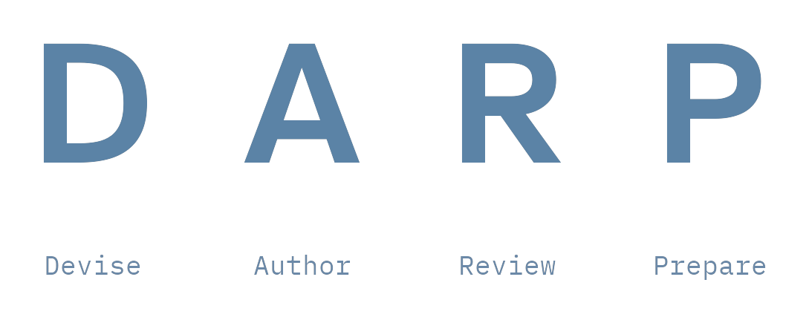
Why DARP?
Practical DARP
Technical DARP
Credit for the work as a whole
Provenance down to the character
<D01:A01:R01:P01>The idea for this passage was one person’s while this first sentence was written by another.</A01><A02:R02>A second author wrote this one, with a second reviewer joining to check it. </A02></R02><A01:R03>And the first author came back for the last sentence verified, this time, by a third.</D:/A:/R:/P>
LAYER FIRST
DAP – Sara Chen
R – ChatGPT 5.5 (ai)
CONTRIUBTOR FIRST
ChatGPT 5.5 (ai; review)
Sara Chen (devise; author; prepare)
DARP
(CC BY 4.0)
commonllama
(Apache 2.0)
commonFrame
(AGPL 3.0†)
† with exception

Slide 6
THE CLEAR BOX PLAYERS PRESENT
4 LAYERS IN 60 SECONDS
A monostich in one act
Victoria Brame · Chris Macek
Co-Founders, Clear Box

Slide 7
The Layers, applied to our monostich
D
Devise
Victoria
Deciding what to make.
A
Author
Chris
Making the work exist.
R
Review
Victoria
Giving the audience a reason to trust the work.
P
Prepare
Victoria
Getting the work out and keeping it reachable.

Slide 8
Let’s make a group haiku. 3-5-3.
OUR TURN
THE FORM — SYLLABLES PER LINE
IN CHAT
3
1
Topic ideas!
5
2
Lines, or the whole poem
3
3
Thumbs up or down: valid 3-5-3?

Slide 9
Let’s make a group haiku. 3-5-3.
OUR TURN
THE FORM — SYLLABLES PER LINE
IN CHAT
3
1
Topic ideas!
5
2
Lines, or the whole poem
3
3
Thumbs up or down: valid 3-5-3?

Slide 10
Let’s make a group haiku. 3-5-3.
OUR TURN
THE FORM — SYLLABLES PER LINE
IN CHAT
3
1
Topic ideas!
5
2
Lines, or the whole poem
3
3
Thumbs up or down: valid 3-5-3?

Slide 11
The Layers, applied to our 3-5-3 haiku
D
Devise
[Topic Contributor(s)]
Deciding what to make.
A
Author
AI+OER Institute Attendees
Making the work exist.
R
Review
AI+OER Institute Attendees
Giving the audience a reason to trust the work.
P
Prepare
Chris
Getting the work out and keeping it reachable.

Slide 12
Remixing, Attribution & AI: Still an Honest Fiction
WHAT IS A REMIX?
A NEW WORK
THE SAME WORK, GROWING
The source was directly remade.
The contributors’ call.
“The Odyssey”
video; 2026
Replace every part on a ’90s Camaro.
Is it still a ’90s Camaro?
There is never going to be a great answer.
DA - Christopher Nolan
R - Jennifer Lame
P - Universal Pictures *
based on “The Odyssey” (text; c. 700 BC)
doi:10.5555/homer.odyssey
Same work. Same record.
It simply grows.
PIN IT: doi: sha256: tasl:
* wildly simplified — the real credits carry many, many more
Attribution hasn’t changed. DARP just gives it a shape.

Slide 13
Now a 5-7-5 haiku, with AI.
AI’S TURN
THE FORM — SYLLABLES PER LINE
HOW THIS RUNS
3
5
1
Chris prompts Gemma, locally
→
5
→
7
2
Gemma adapts our poem — same message, new form
3
→
5
3
You count it: thumbs up or down — valid 5-7-5?
“Rewrite this 3-5-3 haiku as a 5-7-5 haiku. Preserve the message, and keep as much of the original wording as you can.”

Slide 14
Now a 5-7-5 haiku, with AI.
AI’S TURN
THE FORM — SYLLABLES PER LINE
HOW THIS RUNS
3
5
1
Chris prompts Gemma, locally
→
5
→
7
2
Gemma adapts our poem — same message, new form
3
→
5
3
You count it: thumbs up or down — valid 5-7-5?
“Rewrite this 3-5-3 haiku as a 5-7-5 haiku. Preserve the message, and keep as much of the original wording as you can.”

Slide 15
Now a 5-7-5 haiku, with AI.
AI’S TURN
THE FORM — SYLLABLES PER LINE
HOW THIS RUNS
3
5
1
Chris prompts Gemma, locally
→
5
→
7
2
Gemma adapts our poem — same message, new form
3
→
5
3
You count it: thumbs up or down — valid 5-7-5?
“Rewrite this 3-5-3 haiku as a 5-7-5 haiku. Preserve the message, and keep as much of the original wording as you can.”

Slide 16
The Acts: Naming contribution more precisely
Devise
Author
Review
Prepare
Deciding what to make
Making the work exist
A reason to trust the work
Out the door and reachable
Originator
Maker
Reviewer
Finisher
Shaper
Performer
Verifier
Distributor
Backer
Adapter
Refiner
Keeper
Curator
THE RECORD GROWS — SAME WORK, SAME RECORD
[Topic Contributor] (devise)
AI adapted. We made.
Different acts, same layer; both true.
No scope words. No rankings.
AI+OER Institute Attendees (author: maker; review)
Gemma StyleTune (ai; author: adapter)
← the new line
Chris Macek (prepare)

Slide 17
AI Disclosure Statements
dis·clo·sure — revealing something that would otherwise stay hidden
“The nominator interviewed [nominee] and took extensive notes on both her work and project history. The nominator also had access to [nominee’s] CV and supporting evidence submitted for a previous award nomination. The nominator fed these three documents to ChatGPT along with the nomination format/requirements and edited the output accordingly. The nominator also infused her own content/writing throughout and consulted others on her team for peer editing.”
“I used AI to write and edit this nomination.”
Did you use AI? ☐ Yes ☐ No
2025 OEAward nominations · 92% responded · 69% disclosed use

Slide 18
“I didn’t use AI.”
“I have condensed the description for you to copy to the nomination form”
...left at the top of the pasted passage

Slide 19
Stop “Disclosing.” Start Crediting.
THREE WAYS PEOPLE HANDLE IT TODAY
Bare disclosure
Elaborate disclosure
Non-disclosure
“I used AI.”
A paragraph of process — honest, but unstructured and unqueryable.
“I didn’t use AI” — with the trail left behind.
THE SAME INFORMATION, AS A RECORD
DAP
— [Nominator]
AI gets a line.
Not a confession box — a credit line, in the same
vocabulary as everyone else on the record.
Every claim has a name on it.
The reader stays the judge.
A
— ChatGPT (ai)
R
— [team peer editors]

Slide 20
A Full Record: The Wetland Field Guide
D
Devise
Maya
originator, shaper
Jordan · Priya · Devon · Amara
A
makers
Author
Claude (ai)
adapter
Jordan · Priya · Devon · Amara
R
reviewers, refiners
Review
Maya
verifier
Felix
finisher
P
Sana
Prepare
distributor
the state OER repository
keeper
Nine contributors, human and AI, every layer — and nobody needed a job title.

Slide 21
Trade Words, Scope Words & The Formal Record
TRADE WORDS — YOUR FIELD’S OWN LANGUAGE
The words a field already uses for its own trades. Each one folds up to one of the thirteen acts.
music:
film:
academic:
journalism:
songwriter
colorist
peer-reviewer
fact-checker
150+ trade words mapped across seven fields
SCOPE WORDS — HOW MUCH SOMEONE CONTRIBUTED
Used when people share the same act. They attach at any of the three levels.
sole
lead
supporting
equal
A formal notation sits under everything we did today for when your work needs it. Never required.
And the why travels, too — your reasoning and pedagogy ride with the work as far as it goes.

Slide 22
Our DARP record
Beyond the Disclosure Statement: Attributing Human-AI Contribution in Shared Work
D
-
Clear Box
A
Chris Macek {equal} · Victoria Brame {equal}
-
Claude Fable 5 (ai) {supporting} · Claude Opus 5 (ai) {assisted}
R
-
Chris Macek · Victoria Brame
P
-
Victoria Brame

Slide 23
References
[1]
Grey, A. (n.d.). AI declaration statement. In Pressbooks template. Kwantlen Polytechnic University. Retrieved August 7, 2026, from https://kpu.pressbooks.pub/booktemplate/front-matter/ai-declaration-statement/
[2]
Levine, A. (2026a, June 21). A "deep dive" (!) into statements of GenAI transparency for Open Education Awards. CogDogBlog. https://cogdogblog.com/2026/06/deep-dive-igenai-transparency-for-oe-awards/
[3]
Levine, A. (2026b, June 13). Transparency of generative AI use in OEAward nominations. OEGlobal. https://www.oeglobal.org/2026/06/13/transparency-genai-use-oeawards/
[4]
OER Commons. (2026, July 24). OER Commons guidance on AI use for OER creation. https://help.oercommons.org/support/solutions/articles/42000118367-oer-commons-guidance-on-ai-use-for-oer-creation

Slide 24
Closing
Keep exploring… and try to break it. ☺
SESSION RESOURCES
clrbx.org/ai-oer-institute-2026
TELL US WHERE IT BREAKS
FIND US IN OCTOBER
clrbx.org/darp/comment/
clrbx.org/darp/propose/
OEGlobal 2026 Round Table · Thursday, October 8
“Who Gets Credit When AI Shares the Work? A Provenance Conversation”
OpenEd26 Lightning Talk · October 27-29
“Sowing Discord for Iterative Discovery: AI Roundtables Built on Friction”
CONNECT
hello@clrbx.org
Beyond the Disclosure Statement: Attributing Human-AI Contribution in Shared Work © 2026 by Clear Box is licensed under CC BY 4.0

